Slide 1
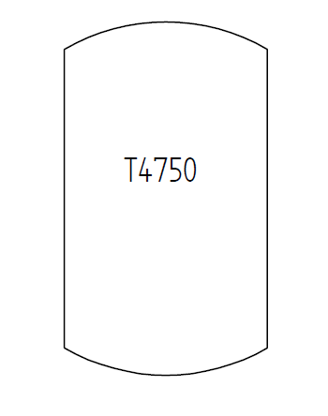
Test Case E01V02 – Tank
a tank with a tag name
(no information about tag name parts: prefix, sequence number, suffix)

